Slide 1


PLASTIC
MEMORY
SEMINAR
SAURABH MARUTI DESHMUKH 10303320181124513005

Slide 2
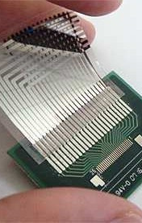
CONTENTS
01
Introduction
02
PEDOT
03
Types of memory
04
Construction
05
Reading and writing
06
Analysis
07
Applications
08
Conclusion
09
Future scope

Slide 3
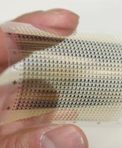
PLASTIC
MEMORY
THIS NEW MEMORY TECHNOLOGY IS CREATED BY USING A CONDUCTING PLASTIC WHICH HAS THE POTENTIAL TO STORE A MEGABIT OF DATA IN A MILLIMETER-SQUARE DEVICE - 10 TIMES DENSER THAN MAGNETIC MEMORIES.
THE DEVICE SHOULD ALSO BE CHEAP AND FAST, BUT CANNOT BE REWRITTEN, SO WOULD ONLY BE SUITABLE FOR PERMANENT STORAGE.
SIMPLICITY IN STRUCTURE, FREE READ AND WRITE CAPABILITY, BETTER SCALABILITY, 3-D STACKING ABILITY, LOW-COST POTENTIAL, AND HUGE CAPACITY OF DATA STORAGE.

Slide 4
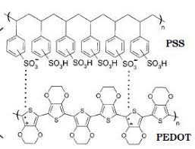
The material is a blend of a negatively-charged polymer called PSS and a positivelycharged one called PEDT+
no.1
PEDOT
no.2
It is the basic non-conducting polymer used in the construction of plastic memory.
no.3
The PEDOT-based memory card consists of a grid of circuits comprising polymer
fuses.

Slide 5
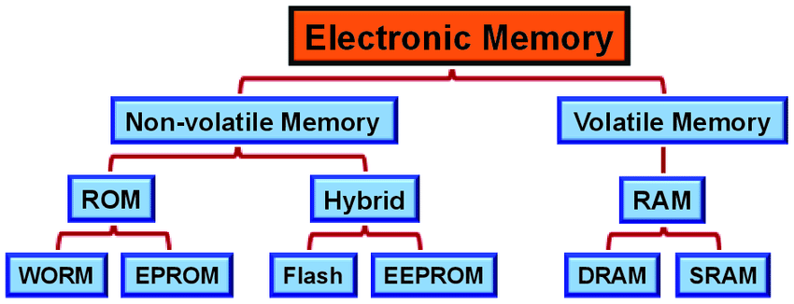
TYPES OF MEMORY

Slide 6

CONSTRUCTION
Step 2
Step3
Step1
A two-terminal device in which an organic semiconducting polymer is sandwiched between two electrodes, indium doped tin oxide (ITO) and aluminum.
The PEDOT-based memory card consists of a grid of circuits comprising polymer
fuses.
A large applied current causes specific fuses to ”blow,” leaving a mix of functioning and non-functioning connections.

Slide 7
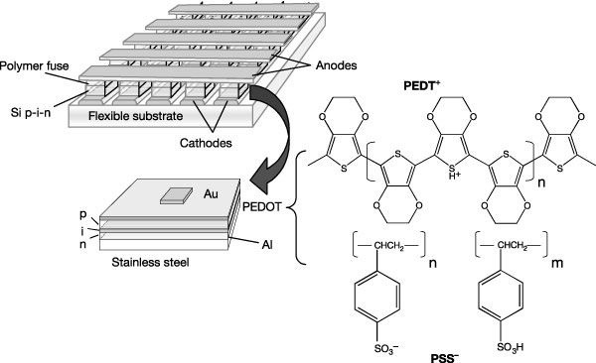

Slide 8
READING AND WRITING THE MEMORY
Reading
Writing
A current is passed which gives a binary coded internal circuit in result.Once done the record is permanent and hence
it cannot be rewritten.
To write a space charge to the device, they applied a positive 20-second, 3-volt pulse.
To read the memory, they run current through the top wire and measure the current in the bottom wire. No current means the bit is a zero, and vice versa. To read the state, they used a 0.2-volt, one minute pulse.

Slide 9
ANALYSIS
no.1
No.of transistors:
The Thin Film system requires about 0.5 million transistors per
gigabit of memory.
no.2
Speed :
read/write cycle times that are 10 times faster than Compact Flash, which are typically 2- 10MB/s read, 1-4MB/s write.
no.3
Cost :
It costs about 5 percent as much to manufacture compared to silicon based memory.

Slide 10


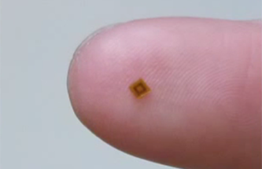
APPLICATIONS
RADIO FREQUENCY IDENTIFICATION (RFID)
ELECTRONIC MAP
MEDICAL APPLICATION
A specific point application for low-cost organic devices is the radio frequency
identification tag (RFID)
By combining with electro chromic displays, these memories could be used to make electronic maps on paper or plastic substrates.
It can be used in tiny sensors which can work 24 hrs to track BP, heart rate, sugar
level.

Slide 11
Conclusion
Plastic memory is much lower and faster than the existing silicon a circuit was invented by Researchers at Princeton Organization working with Hewlett-Packard.
Plastic memory is a combination of materials that could lower the cost and power the density of electronic memory.
It is an all-organic memory system with manifold advantages: in speed, production, energy consumption, storage ability and cost.
The memory cannot be rewritten, but can be read very fast and with low power consumption. So this would be perfect only for permanent storage.

Slide 12

Future scope
With the amount of incresing data in the world, a cost efficient way of storing physical data on servers is very important. Also the e-waste harm due to use of silicon proves the polymer a better alternative in this regard. Use of a production method to produce a bio-degradable polymer can solve a majority of problems currently faced by humanity.
As plastic memory technology advances, it could pave the way to computers made entirely of plastic electronic components, from the display to the logic chip. That may be decades off, but as researchers push the bounds of polymers, the vision seems less far-fetched.

Slide 13

Thank
you!

